Slide 1
GENDER INEQUILITY IN WORKPLACE SRI LANKA

Slide 2
Table of contents
01
02
04
03
INTRODUCTION
CHARACTERISTIC OF THE QUESTIONNAIRE
HOW TO COLLECT DATA
LIMITATION

Slide 3
05
06
RECOMMENDATION
CONCLUSION

Slide 4
01
INTRODUCTION

Slide 5
Introduction
Gender inequality in the workplace is a pressing issue that affects individuals, organizations, and societies worldwide. Despite significant advancements in gender equality efforts, disparities persist in various aspects of employment, including representation, pay, and opportunities for advancement. In the context of Sri Lanka, where cultural norms and societal expectations intersect with economic and organizational dynamics, understanding the nuances of gender inequality is paramount.

Slide 6
CHARACTERISTIC
OF THE QUESTIONNAIRE
02

Slide 7
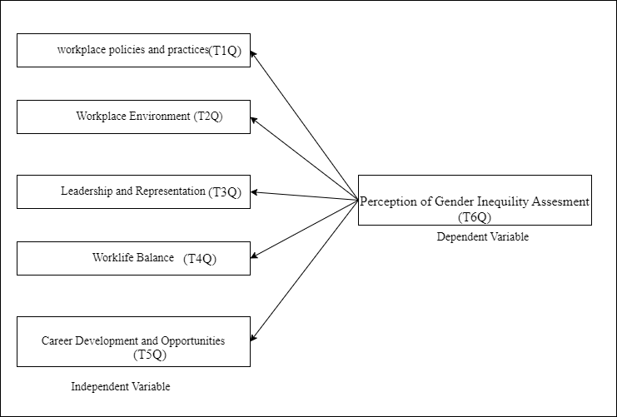

Slide 8
HOW TO COLLECT DATA ?
03.

Slide 9
We entered our questions and created a google form and shared it among two hundred selected employees in the Sri Lanka and found the data we needed.

Slide 10
LIMITATION
04.

Slide 11
Sample Bias: The findings are based on a specific sample of respondents and may not be fully representative of the entire workforce in Sri Lanka. Sample bias could affect the generalizability of the results.
Self-Reported Data: The data collected relies on self-reported responses from participants, which may be subject to social desirability bias or inaccuracies due to memory recall.
Scope of Variables: The questionnaire focused on specific aspects of gender inequality and may not capture the full complexity of the issue. Other relevant variables or factors influencing gender inequality in the workplace could have been overlooked.
Cross-Cultural Considerations: Cultural nuances and differences within Sri Lanka may influence perceptions and experiences of gender inequality differently across regions or demographics. These factors were not extensively explored in this study.
Temporal Limitations: The data collected reflects a specific point in time and may not capture changes or developments in gender dynamics in the workplace over time.

Slide 12
RECOMMENDATION
05.

Slide 13
Policy Reform
Training and Awareness Programs
Mentorship and Networking Opportunities
Flexible Work Arrangements
Transparent Performance Evaluation Processes
Supportive Organizational Culture
Collaboration with External Partners

Slide 14
CONCLUSION
06.

Slide 15
In conclusion, the analysis sheds light on the prevalence of gender inequality in the workplace in Sri Lanka. Key findings indicate disparities in various aspects such as representation, pay, and opportunities for career advancement. The high reliability of the questionnaire and significant correlations observed underscore the importance of addressing gender inequity as a critical issue in organizational settings.
Moving forward, efforts to promote gender equality should be multifaceted and comprehensive, encompassing policy changes, organizational culture shifts, and targeted interventions. Strategies such as implementing gender-sensitive policies, providing equitable opportunities for career development, and fostering inclusive workplace cultures are crucial steps toward achieving gender parity.
It is imperative for stakeholders, including employers, policymakers, and civil society organizations, to collaborate in advancing gender equity agendas and creating environments where all individuals, regardless of gender, can thrive and contribute their fullest potential. By prioritizing gender equality initiatives, we can create more equitable and sustainable workplaces that benefit society as a whole.

Slide 16
THANKS !!!
MAHNDSE232F-025 G.A.DILMI
MAHNDSE232F-024 J.I.HEWAPATHIRANA
MAHNDSE232F-035 A.P.S.I.KUMARA
MAHNDSE232F-034 P.S.T.WEERATHUNGA

